Slide 1
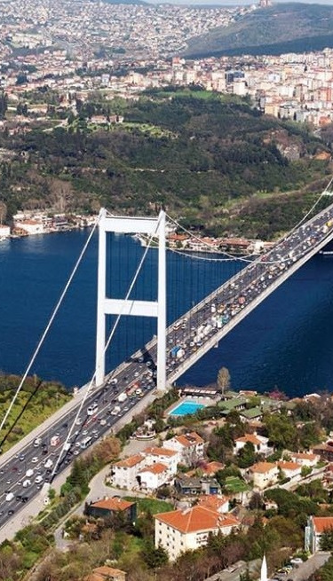
TASTE OF TWO CONTINENTS
We bring the flavors of Turkey to the center of Europe. The business plan of the restaurant chain called “Taste Of Two Continents”, which will breathe new life into the culture of eating out in Europe.
•CHIEF EXECUTIVE OFFICER(CEO): ÖMER DINER
•Zikova 702 16 000 Praha 6
• +420 774 877 957
•omerdiner90@gmail.com

Slide 2

EXECUTIVE SUMMARY
Taste of Two Continents is a chain of restaurants aimed at bringing Turkish cuisine to Europe at affordable prices. By focusing on originality and effective marketing, we plan to take advantage of the growing demand for ready-made meals and the curiosity of European consumers to explore different cuisines.
Our strategy includes targeting Turks residing in Europe to build a loyal customer base first and at the same time expanding our menu to address wider interests. We will build a strong brand presence through offline and online advertising campaigns and interact with customers through social media.

Slide 3
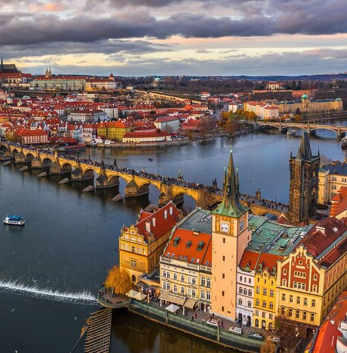
REASONS FOR CHOOSING PRAGUE AS THE LOCATION FOR OUR FIRST RESTAURANT
Tourist Attraction
Cost Advantage
Market Demand

Slide 4


COMPANY
Who are we?
Taste Of Two Continents is a restaurant chain focused on introducing Turkish cuisine to Central Europe. Our core identity lies in our dedication to offering authentic and affordable traditional Turkish foods. Additionally, we aim to cater to the evolving tastes and curiosity of European consumers by expanding our menu to include a diverse range of Turkish dishes.

Slide 5



COMPANY
STRENGTHS
Cost Advantage: Taste of Two Continents benefits from low costs, enabling it to offer affordable prices to customers.
Skilled Management Team: The company's management team possesses expertise in various areas, including traditional Turkish cuisine, marketing and financial administration, ensuring efficient operations.
SuccessfulMarketing Techniques: Taste of Two Continents has implemented effective marketing strategies that have contributed to its success in reaching and attracting customers.
Commitment to Authenticity: By adhering to traditional Turkish recipes and ingredients, the company sets itself apart from competitors, offering an authentic dining experience.

Slide 6

COMPANY
WEAKNESSES
Limited Customer Reach: Focusing on a specific cuisine may limit the potential customer base, restricting growth opportunities.
Vulnerability to Economic Conditions: During economic recessions, consumers tend to cut back on dining out, opting for cheaper alternatives. This poses a risk to Taste of Two Continents' business.

Slide 7

COMPANY
OBJECTIVES
Menu Expansion: Broaden the menu to include a wider range of Turkish dishes, including local alcoholic drinks, to cater to evolving consumer preferences.
Expansion into Major European Cities: Open restaurants in at least three different European cities within five years to increase brand presence and market reach.
Effective Marketing and Community Building: Implement targeted marketing campaigns and engage with the community to establish a strong brand presence and foster customer loyalty.
Online Ordering and Delivery: Venture into the online ordering and delivery business to meet the growing demand for convenient food access and reach a wider customer base.

Slide 8
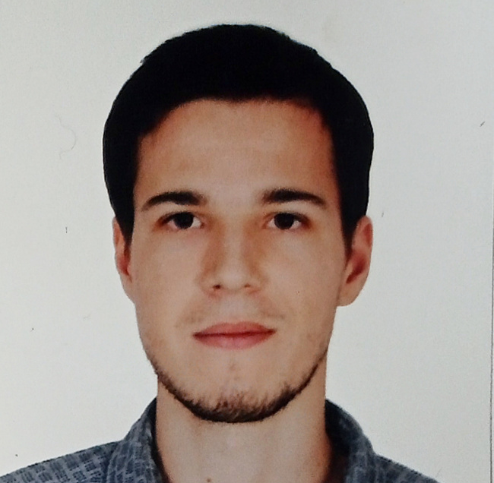
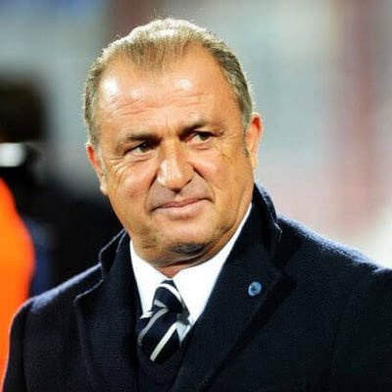
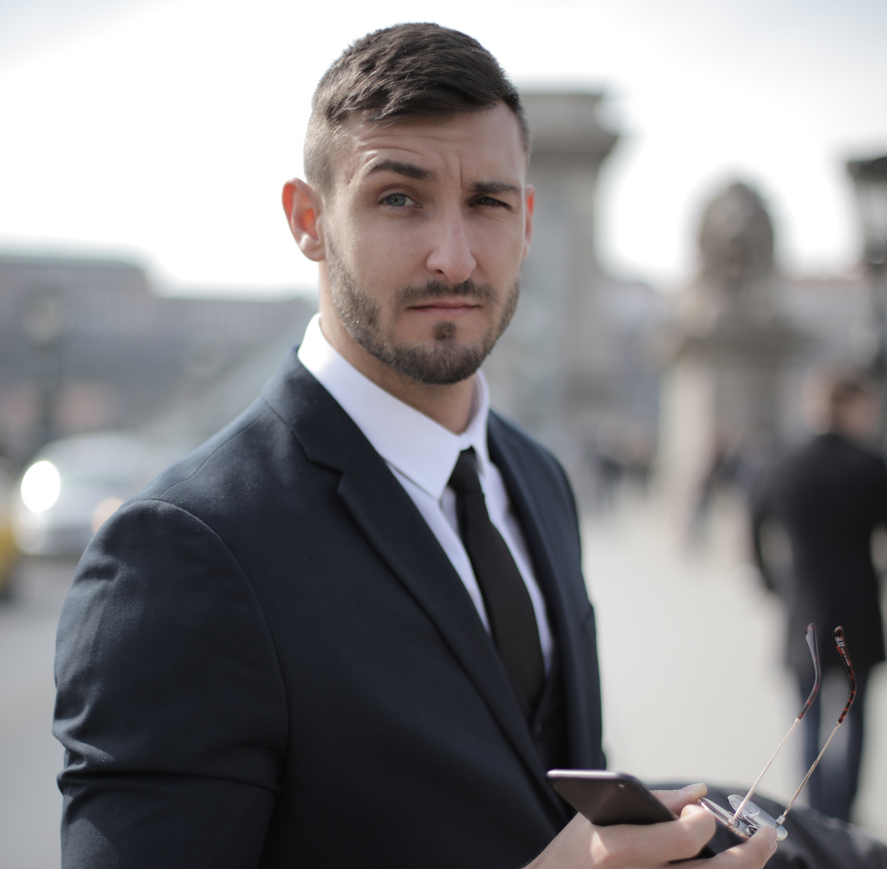

THE MANAGEMENT TEAM
COMPANY
Ömer Diner
Mustafa Elikan
Paul Johnson
Fiona Sal
CEO
Head Chef
CFO
CMO

Slide 9

MARKETING
Let’s analyze the current market first.
What is the market?
The market for Taste of Two Continents is the European food industry with a specific focus on introducing Turkish cuisine to European consumers. The
market includes individuals who are interested in exploring different cuisines and experiencing Turkish food. It includes both local European consumers and Turkish expatriates living in Europe.

Slide 10



MARKETING
OUR STRATEGY
Branding and Positioning: Develop a strong brand identity that emphasizes the authenticity and quality of Turkish cuisine. Position Taste of Two Continents as the top choice for a fine Turkish dining experience.
Targeted Advertising: Utilize offline and online campaigns to reach Turkish expatriates and European consumers interested in diverse cuisines. Collaborate with influencers, utilize social media advertising and engage local print media to effectively target our audience.
Social Media Engagement: Actively engage with customers on social media, share behind-the-scenes content and promote user-generated content. Focus on platforms like Instagram to reach a wider audience and foster a strong online community.
Partnerships and Collaborations: Establish strategic partnerships with local businesses, tourism agencies and event organizers to increase visibility. Collaborate on promotions and leverage referrals to attract both locals and tourists to our restaurants.

Slide 11
PRODUCT
WHAT WE OFFER?
WE AIM TO DO MORE THAN JUST SATISFY YOUR HUNGER. WE OFFER THE FOLLOWINGS:
Authentic Turkish Flavors:
Culinary Discovery:
Indulge in the essence of Turkish cuisine with aromatic spices and cooking techniques.
Explore Turkey's rich culinary heritage with a diverse menu beyond doner kebab.
Quality and Freshness:
Impressive Dining Environment:
Enjoy dishes made with high-quality ingredients and a commitment to freshness.
Immerse yourself in Turkish culture through our captivating ambiance and warm hospitality.

Slide 12
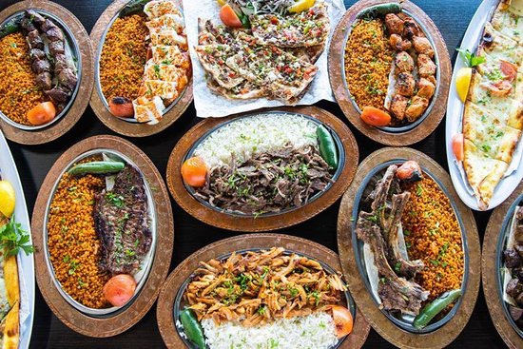
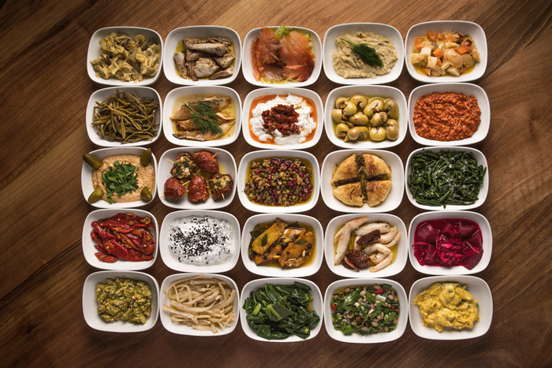
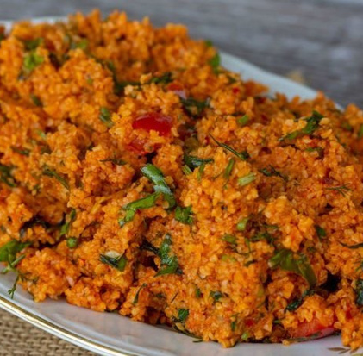
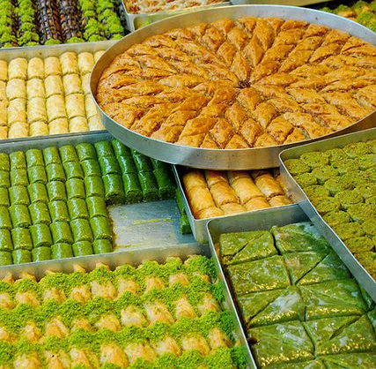
PRODUCT
OVERVİEW OF OUR MENU
MAIN DISHES
MEZES
VEGETARIAN
DESSERTS
200-300 CZK
50-60 CZK
80-150 CZK
100-150 CZK

Slide 13

SALES AND PROMOTION
SALES APPROACH
We prioritize creating an unforgettable dining experience through excellent customer service and emphasizing the unique aspects of Turkish cuisine. Our goal is to make our guests feel valued and ensure they enjoy their visit, ultimately turning them into loyal customers.

Slide 14
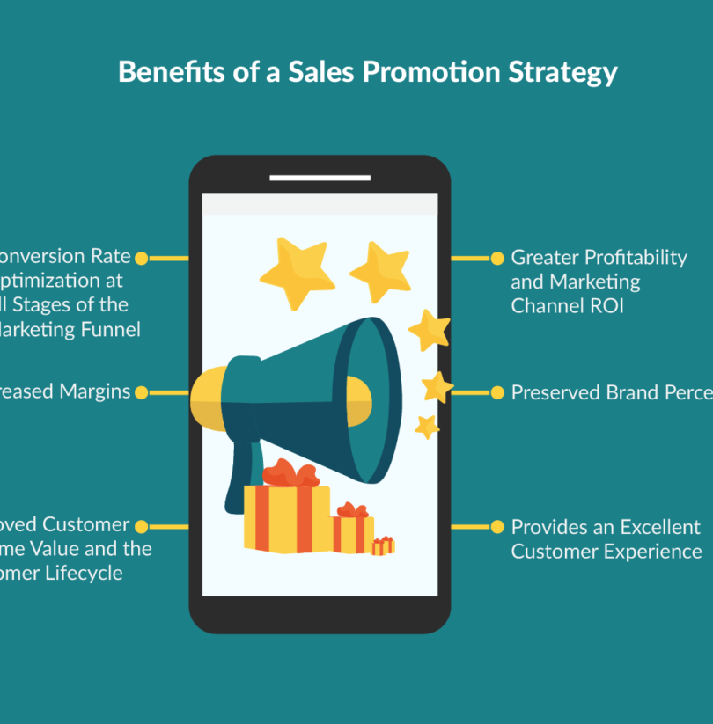
SALES AND PROMOTION
PROMOTION STRATEGIES
Our promotion strategies combine online and offline channels to maximize reach. Online efforts include targeted digital marketing, social media engagement and SEO to attract customers seeking Turkish cuisine in Prague. For offline promotion, we utilize traditional advertising methods and establish partnerships with tourism agencies. Collaborating with influencers helps generate positive recommendations and reviews.

Slide 15
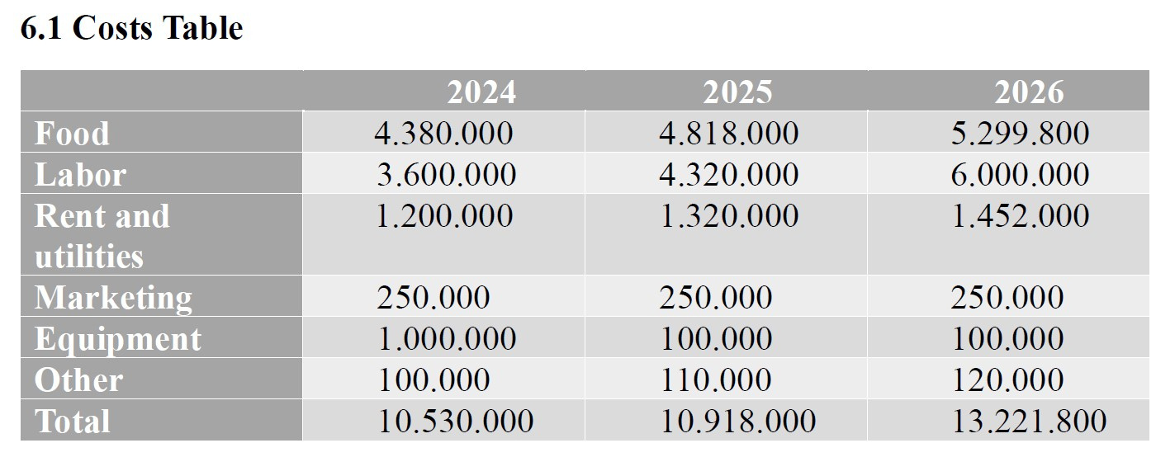
FINANCE
FINANCIAL TABLES
Note: The prices shown here are “estimates” generated by looking at actual data. The actual prices will be revealed once the restaurant is operational.

Slide 16
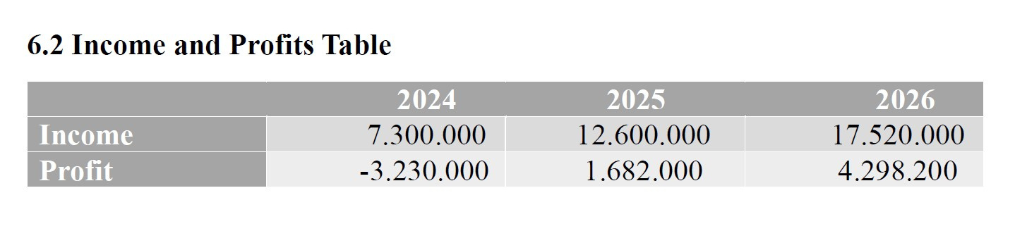
FINANCE
FINANCIAL TABLES
Note: The prices shown here are “estimates” generated by looking at actual data. The actual prices will be revealed once the restaurant is operational.

Slide 17

TASTE OF TWO CONTINENTS
WE NEED YOUR INITIAL INVESTMENT FOR THE FIRST YEAR. I CAN GIVE 530.000 CZK AS ÖMER DINER. WE EXPECT YOUR INVESTMENT FOR THE REMAINING 10.000.000 CZK. AS CAN BE SEEN FROM THE TABLES, OUR RESTAURANT STARTS TO MAKE REGULAR PROFITS AFTER THE FIRST YEAR.

Slide 18
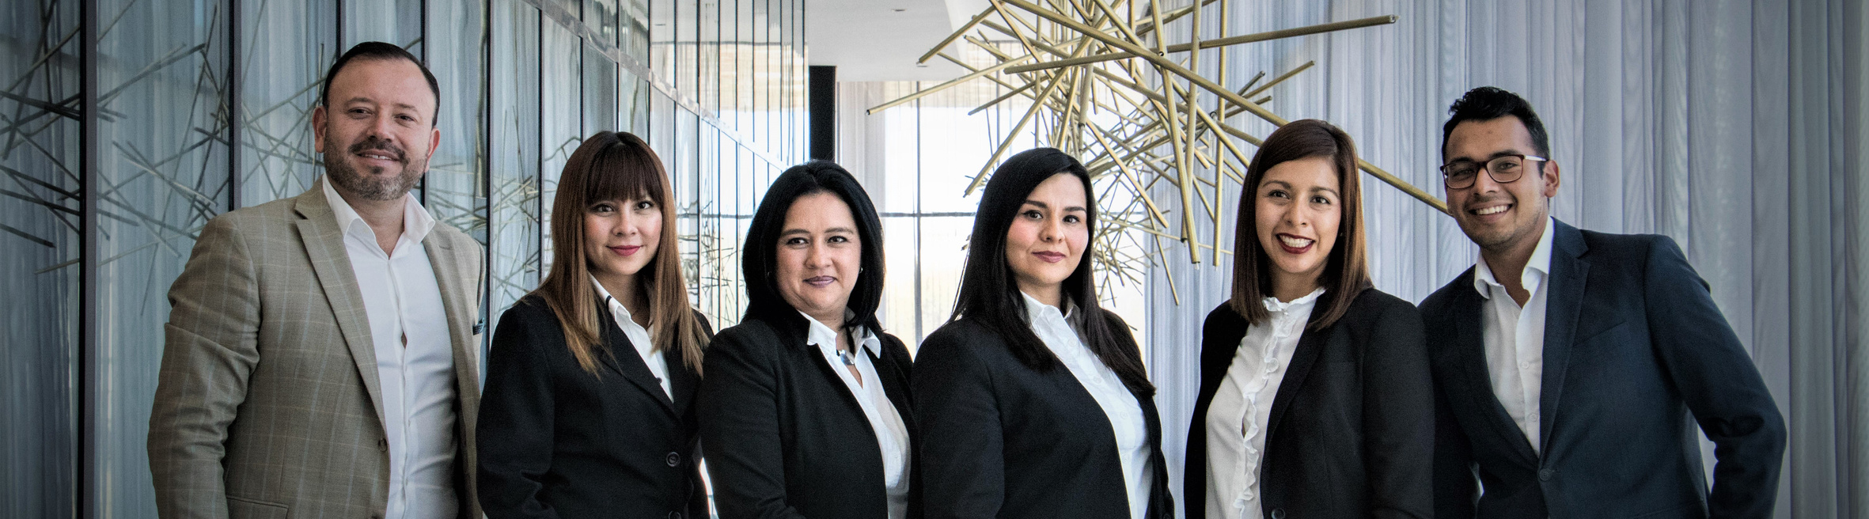
TASTE OF TWO CONTINENTS
THANK YOU FOR YOUR TIME AND CONSIDERATION. WE LOOK FORWARD TO THE POSSIBILITY OF WORKING TOGETHER AND BRINGING DELICIOUS TURKISH CUISINE TO THE EUROPEAN CUSTOMERS.

